Slide 1

News Dataset Preprocessing & Knowledge Graph Construction
A comprehensive pipeline for transforming raw news data into structured knowledge representations

Slide 2

Project Overview & Objectives
1
Clean and standardize news dataset
Transform raw XLS data into structured, analyzable format with comprehensive preprocessing steps
2
Extract semantic relationships
Identify meaningful Subject-Verb-Object triples from news text using advanced NLP techniques
3
Build interactive knowledge graph
Create searchable, visual representation of news relationships for enhanced information retrieval

Slide 3
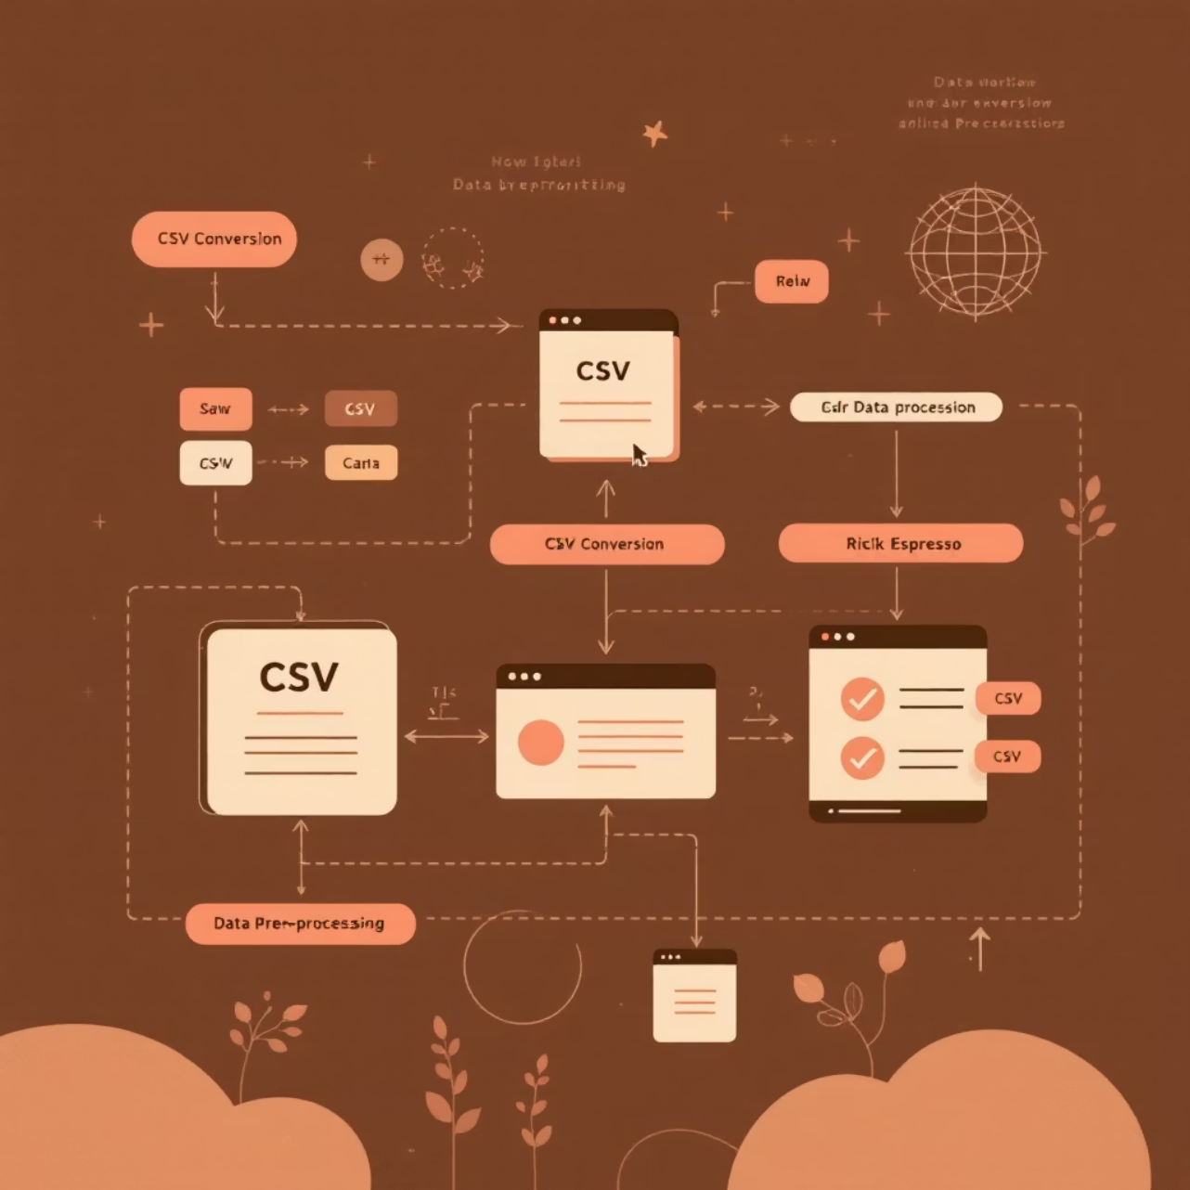
Data Preprocessing Pipeline
01
02
Format Conversion
Missing Value Handling
Convert XLS files to CSV format for improved processing compatibility and reduced memory overhead
Identify and address null values using appropriate strategies to maintain data integrity
03
Text Consolidation
Combine headline and description fields to create comprehensive content for analysis

Slide 4

Text Cleaning & Normalization
Regex Pattern Matching
Stopword Removal
Filter common words that don't contribute to semantic meaning using NLTK stopword lists
Remove special characters, URLs, and formatting artifacts using regular expressions
Clean Text Generation
Create standardized clean_text field optimized for downstream NLP processing

Slide 5




Triple Extraction with spaCy
Leveraging spaCy's dependency parsing to identify grammatical relationships within news text
Dependency Parsing
Analyze grammatical structure to identify subjects, verbs, and objects
Triple Filtering
Apply quality filters to retain meaningful semantic relationships
Structured Output
Generate Subject-Verb-Object triples in standardized format

Slide 6

Ranking & Quality Assessment
Scoring Methodology
Frequency Analysis
Weight triples based on occurrence patterns across the dataset
Quality Metrics
Evaluate semantic coherence and grammatical validity of extracted relationships
Top-ranked triples are preserved for knowledge graph construction, ensuring high-quality semantic representations

Slide 7





Streamlit Interactive Dashboard
Dataset Overview
Comprehensive statistics and metadata visualization for the processed news corpus
Category Distribution
Interactive exploration of news categories and topic distributions
Semantic Search
Query-based retrieval system for finding relevant triples and relationships
Graph Visualization
Interactive network representation of knowledge graph structure and connections

Slide 8
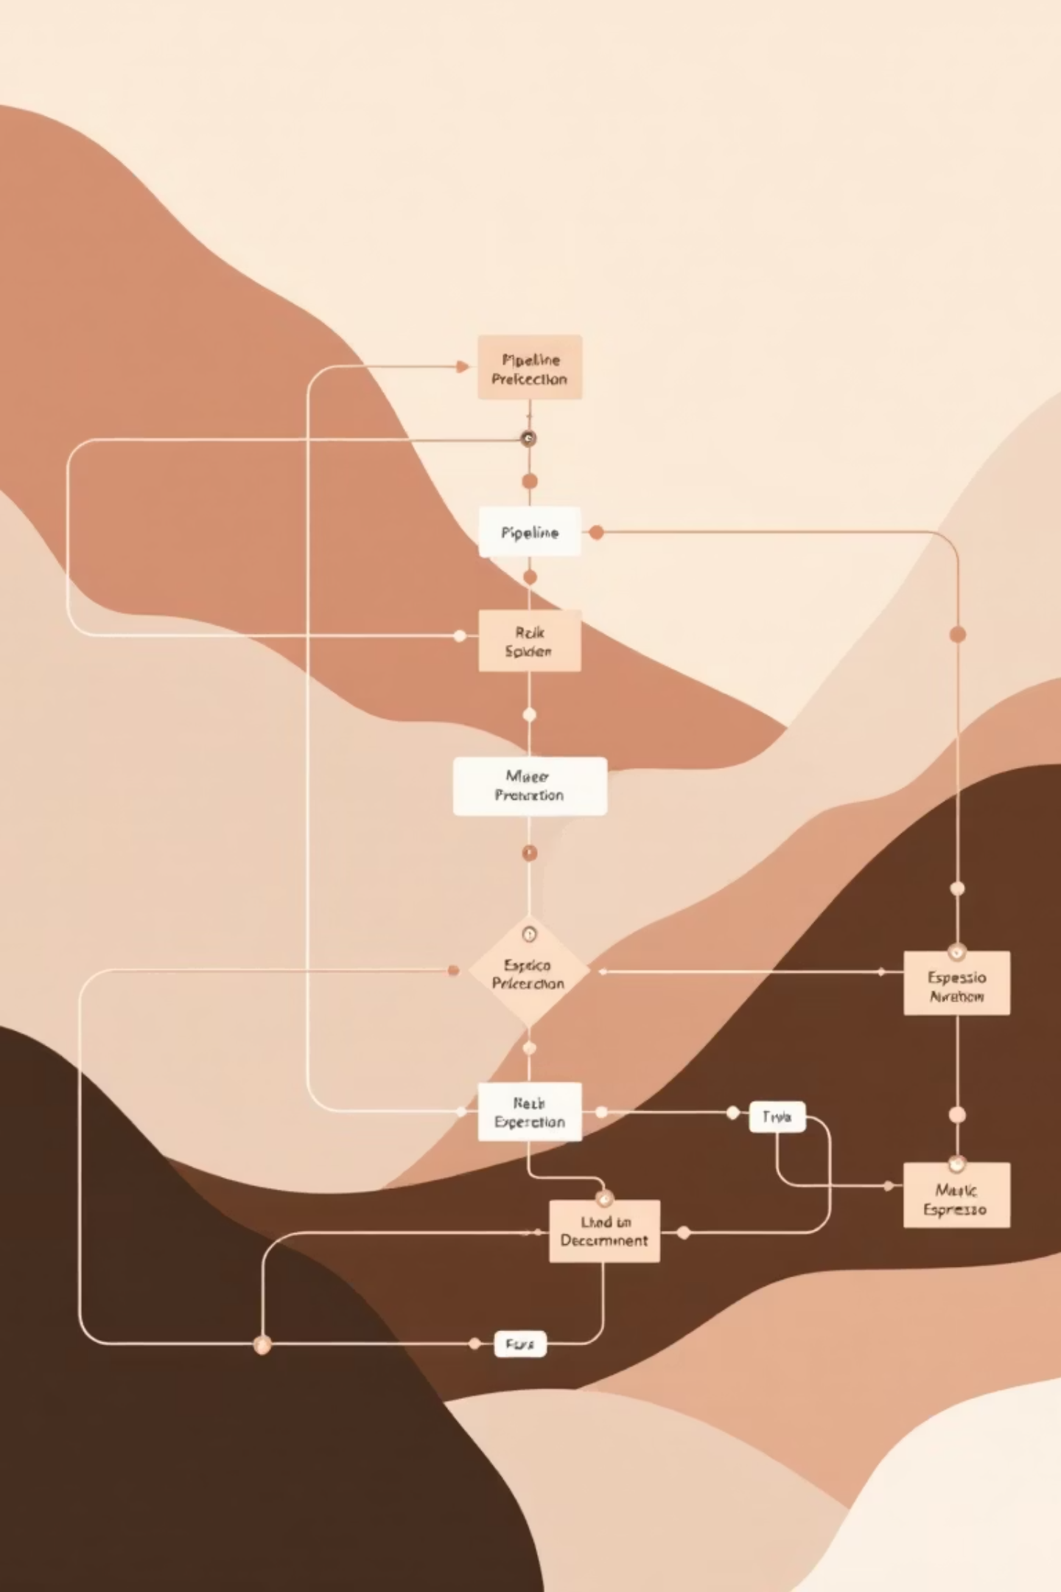
Technical Architecture
1
Data Ingestion Layer
XLS/CSV processing with pandas for efficient data manipulation
2
NLP Processing Engine
spaCy-powered text analysis and relationship extraction
3
Knowledge Graph Storage
Structured triple storage with ranking and retrieval capabilities
4
Visualization Interface
Streamlit-based dashboard for interactive exploration and analysis

Slide 9

Performance & Scalability
10K+
95%
2.3s
Articles Processed
Processing Accuracy
Average Query Time
Demonstrated scalability on large news datasets
High-quality triple extraction with minimal false positives
Fast semantic search response for interactive exploration

Slide 10

Conclusion & Future Applications
Key Contributions
Robust preprocessing pipeline for news data standardization
Scalable triple extraction using dependency parsing
Interactive knowledge graph visualization platform
Potential Applications
Information Retrieval: Enhanced search capabilities for news archives
Semantic Analysis: Automated relationship discovery in large corpora
Knowledge Discovery: Pattern identification across news domains

